Slide 1
Moaki – Travel Social Media
BY Team Duracell
A social media-style travel application where users can document the places they've visited
and meet like-minded people.

Slide 2
Product Vision
Long term, our primary goal is to establish ourselves as the go-to destination for travelers all over the world and the starting point of numerous amazing adventures.
We will measure our success by checking the number of monthly active users, user engagement metrics and partnerships established with travel industry stakeholders.
As for the market opportunities, the social media industry is a $231.1 billion market with a diverse and growing user base of people seeking unique experiences and connections.
Moaki competes with other travel and social media platforms, but its unique focus on community-driven travel content and engagement sets it apart. Our users benefit from opportunities to connect with fellow tourists and make new friends. By using our app, they can discover hidden gems and travel tips from experienced explorers. Plenty of stories will start here, and finding fresh inspiration and suggestions will get easier than before.
Overall, Moaki aims to connect people around the world through travel, one journey at a time, by becoming the go-to social media platform for travelers.
Moaki is a travel social media app that connects travel enthusiasts, explorers and individuals seeking travel inspiration and connections within the global travel community.
A large number of people are passionate about traveling, but face challenges in finding a dedicated platform to share their experiences, connect with like-minded travelers and discover new destinations and travel-related content.
Moaki provides a vibrant and colourful community for travelers to share their adventures, connect with others and access travel-reviews, tips and advice. Our app stands out by providing an integrated platform for connecting travelers by interests and destinations, all while offering a personalized travel feed and opportunities to review places and collaborate with others.
Our goals are to grow our user base exponentially month by month and develop partnerships with travel agencies, airlines and hotel chains that could promote themselves within the app.
Moaki will focus on impacting the travel community and enhancing the usual experience for every traveler. The app will promote the freedom of expression, without giving businesses the ability to remove critical comments made about them.

Slide 3
Product Features and Functionalities
Account management
Functionality | Feature
A user should be able to create an account or log in | A Log In / Sign Up page that allows the user to enter his credentials
Allow users to add details, such as profile pictures, bios, and contact information | A button named “Edit profile” on top of the user’s profile page that allows the user to change the way his profile is displayed
Provide options for password changes, email updates, and notification preferences | A section on the “Settings” tab named “Security and Preferences” where the user can take those actions
Functionality | Feature
Users can compose and publish reviews with images, text, location, and ratings for different vacation spots. | “Create new post” buttons on multiple pages that redirect you to a form which allows you to create a post
Users can modify and delete their posted reviews | On their profile page (posts list) or on a post page, there are buttons that allow the editing and the deletion on the post

Slide 4
Product Features and Functionalities
Functionality | Feature
Allow users to express appreciation for posts by liking them | A 💗 button for the post which can be used to like a post. It increases the number of likes
Enable users to engage through comments on others' reviews. | A “show comments” button is placed next to the post; it will redirect to the post’s page that will also display all the comments
Enable users to write, edit and delete comments | A form for writing a comment that is placed under the comment list. Next to their comments, there are “edit” and “delete” options.
Functionalityblut | Feature
Enable users to find posts based on location, ratings, or specific keywords | A tab where you can look up and add new locations - it will redirect you to the reviews page of that location
Enable users to search others by username | You can find users by entering their username in a search bar, or by clicking on their usernames inside the comments
Enable users to follow others | A button next to user’s profile that will mark him as followed / unfollowed
Display a personalized feed for each user | An user’s feed will contain the recent posts of the people he follows, being the default page and accessed from the menu as well

Slide 5
Product Features and Functionalities
Functionality | Feature
Posts Moderation | Admins have an option to delete posts (next to the post)
Comments Moderation | Admins have an option to delete posts (next to the comment)
Users Moderation | Admins have the ability to ban (delete) accounts, next to their user profiles
Functionality | Feature
Users should receive live notifications regarding their posts | There is a sidebar next to the feed that will display in real time likes and comments about their posts

Slide 6
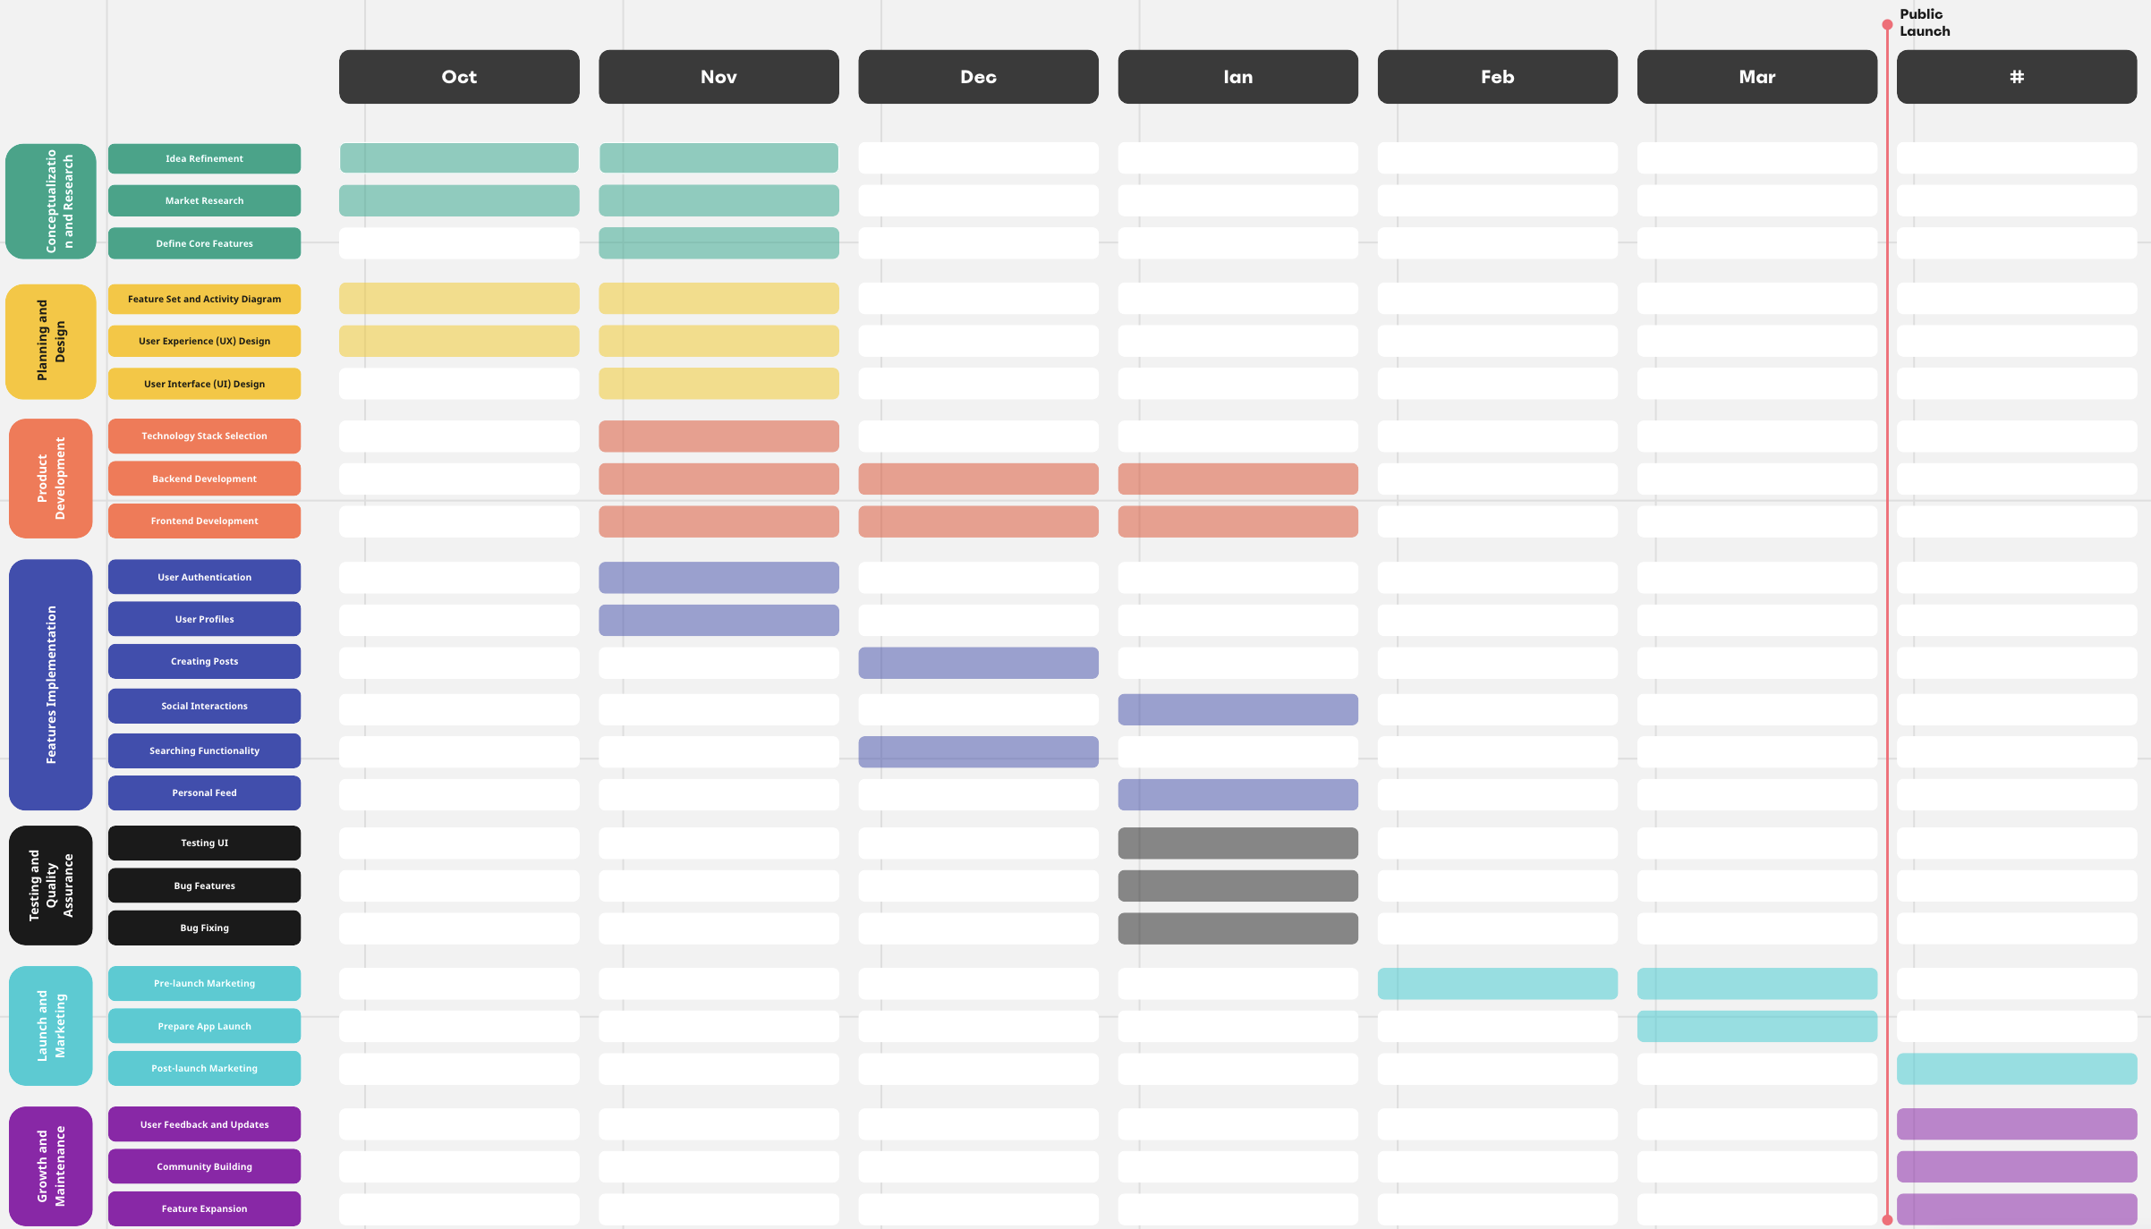
Roadmap

Slide 7
Non-Functional Requirements
Performance:
We should ensure the app achieves low latency and quick response times for user interactions. Specifically, refreshing the feed should take no more than 2 seconds, and publishing a new post should not exceed 5 seconds. These measurable targets will be achieved through the implementation of optimizations in the app infrastructure and codebase, aligning with user expectations and contributing to a positive user experience.
Scalability:
We should improve the app's scalability to handle increased traffic during peak times and accommodate up to 25,000 users in the first phase. We will achieve this by implementing scalable architecture, optimizing database performance, and conducting load testing. Meeting these goals is essential for accommodating a growing user community and ensuring readiness for increased user activity.
Reliability:
We should ensure continuous app availability by minimizing service interruptions(0). We will quantify and achieve targeted reductions(0) in interruptions to enhance the user experience.
Data Protection:
Personal information and user data should be securely stored and encrypted. Users shouldn't be able to access the private personal data of other users, ensuring user privacy and building trust.
Usability and User Experience:
The app should have an intuitive and user-friendly interface, providing a seamless and engaging user experience. We should achieve great usability to positively impact user engagement.
Content Moderation:
The app should have content moderation mechanisms in place in order to prevent inappropriate or harmful content from being posted on the platform.(0

Slide 8
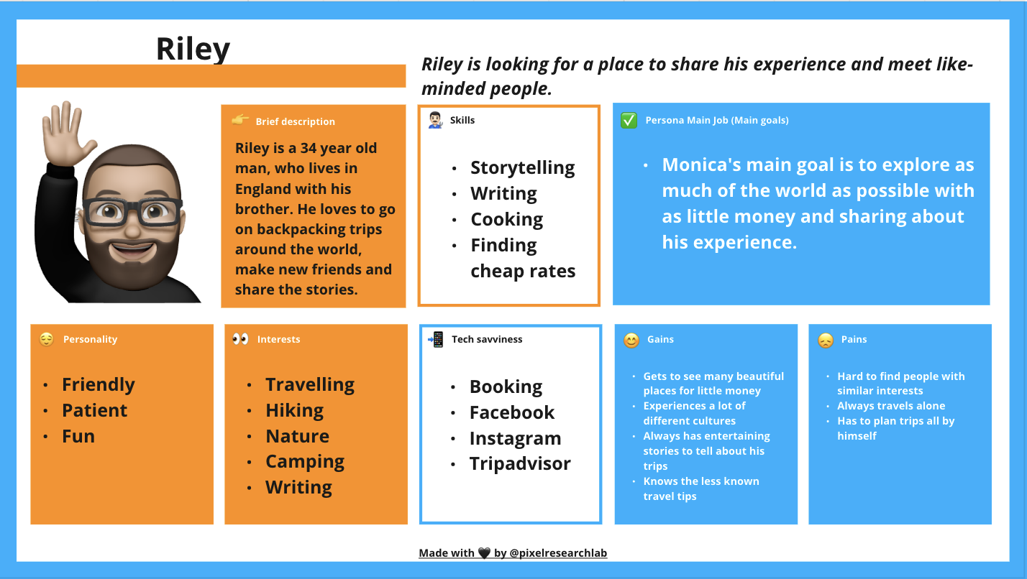
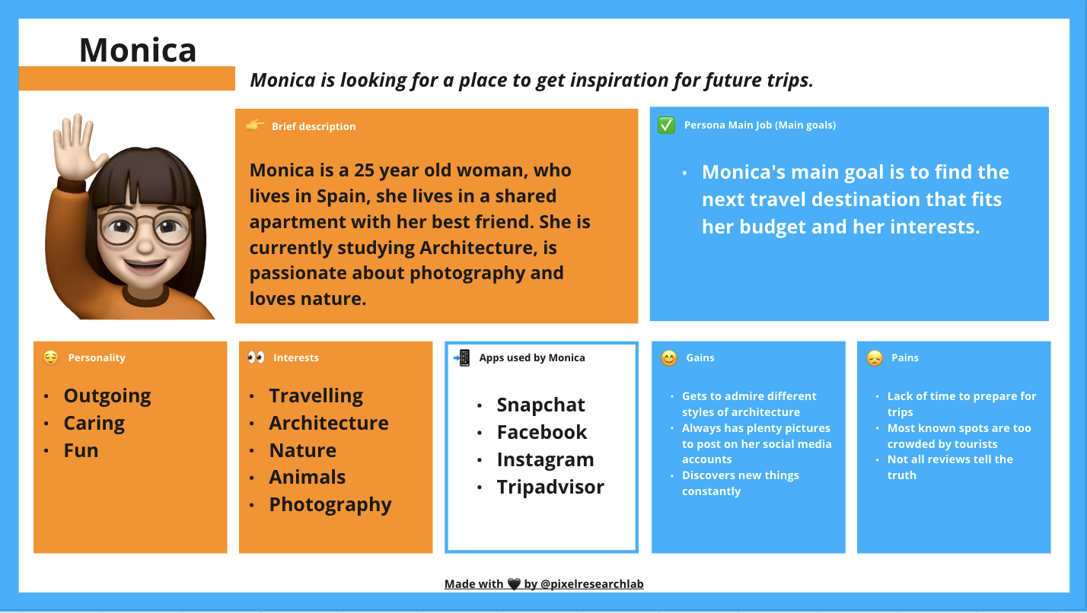
Customer Journey – User Persona

Slide 9
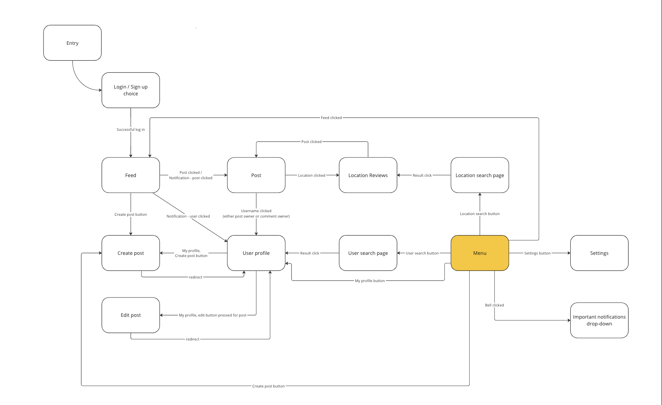
Customer Journey – User Journey

Slide 10
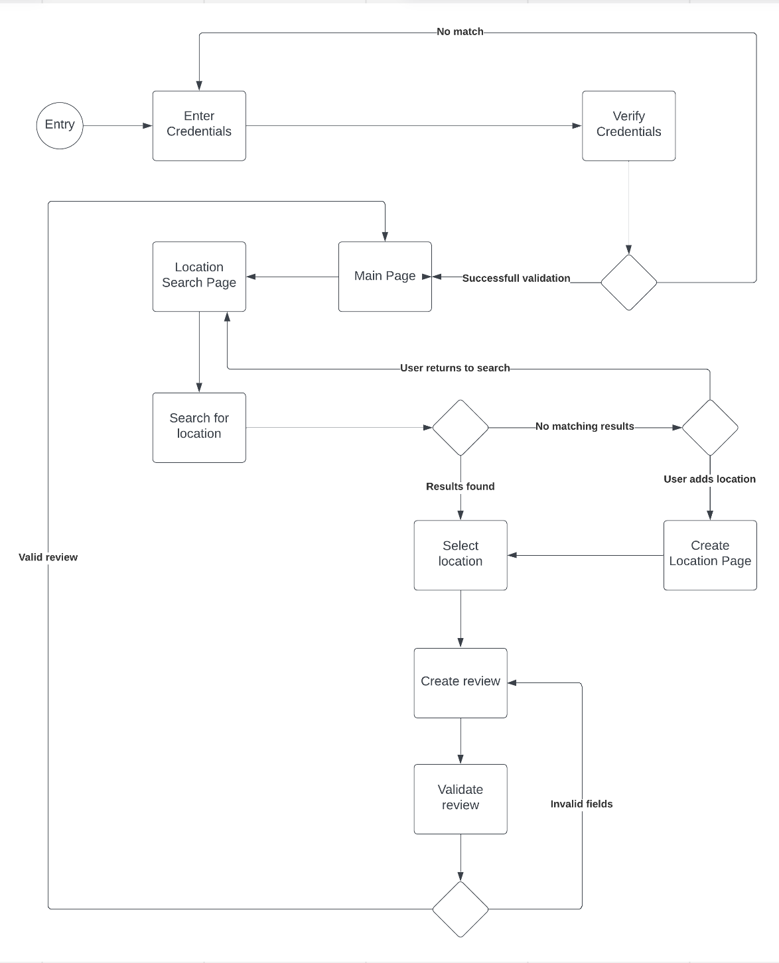
Activity/state diagram

Slide 11
USER Stories
Title: as an admin, I want to be able to see all the posts on the main feed in order to moderate them.
Description: I want to have the option to delete them if they are off-topic or contain harmful language.
Acceptance criteria - positive:
Scenario: A moderator wants to search and delete posts that are off-topic.
Given: Moderator is on the feed page, and sees that kind of review
When: He opts for deleting the post and the post is found in database
Then: The post gets deleted
Acceptance criteria - negative:
Scenario: A moderator wants to search and delete posts that are off-topic.
Given: Moderator is on the feed page, and sees that kind of review
When: He tries to delete on a post that has already been deleted
Then: An error message is displayed, and the page is reloaded
Title: As an Admin, I want to have the option to exclude users for their behavior, so that the application is kept clean.
Description: when on a user profile, I want to have an option that allows me to ban or delete the user.
Acceptance criteria - positive:
Scenario: A moderator sees a user that is breaking the rules
Given: Moderator is on the user’s profile page
When: He goes for the option to ban the user, and the user has normal privileges
Then: The users gets deleted
Acceptance criteria - negative:
Scenario: A moderator sees a user that is breaking the rules
Given: Moderator is on the user’s profile page
When: He goes for the option to ban the user, and the user is a moderator as well
Then: a message error is displayed, suggesting to contact a higher authority for moderator removal

Slide 12
User stories
Title: As a user, I want to be able to create a post for a location, in order to help other users with accurate information.
Description: the post for the location should contain fields for: Title, Location, Images, Description, Rating
Acceptance criteria - positive:
Scenario: a user wants to review a location
Given: user completed the form for the review
When: user chooses to submit the form and the fields are valid
Then: the review is added to the location’s page.
Acceptance criteria - negative:
Scenario: a user wants to review a location
Given: user completed the form for the review
When: user chooses to submit the form, but the fields are either incorrect or invalid
Then: an error message is displayed, and the user is asked to complete the form again with the correct information
Title: As a user, I want to be able to like and leave a comment to a post
Description: the post needs to have an option to like it and an option that opens the comment section on the post page.
Acceptance criteria - positive:
Scenario: a user wants to comment on a post
Given: user completed the form
When: user submits the form, and the post is still in the database
Then: the comment is added to the post
Acceptance criteria - negative:
Scenario: a user wants to comment on a post
Given: user completed the form
When: user submits the form, and the post got deleted
Then: an error message is displayed, and the user is returned to the previous page

Slide 13
User stories
Title: As a user, I want all my posts to be displayed on my profile page
Description: on each user’s page, there should be all the reviews that the user wrote displayed in a mini-view (does not contain comments for example)
Acceptance criteria - positive:
Given: you want to see a user’s posts
When: you access a user’s profile page, and user posted in the past
Then: the user’s posts are rendered.
Acceptance criteria - negative:
Given: you want to see a user’s posts
When: you access a user’s profile page, and user has no posts
Then: a message is displayed, confirming that the user has not posted yet
Title: As a user, I want to be able to edit and delete the posts I have on my page
Title: As a user, I want to be able to edit and delete the comments I wrote.
Title: As a user, I want to have a personal feed filled with recent posts of the users I followed in order to learn more about new places
Title: As a user, I want to be able to edit my profile page (picture, bio etc) and settings.
Description: I want to have an option in the menu that will take me to the settings, and one that will take me to my profile page.

Slide 14
User stories
Title: As a user, I want to have the option to search for users and follow them, in order to see more of their posts in my personal feed
Description: there should be a user search page that contains a search bar and a section that displays the search results.
Acceptance criteria - positive:
Scenario: you want to find an user
Given: you are on the user search page
When: you type an username in the search bar, and results are found
Then: a list of users with matching usernames is displayed
Acceptance criteria - negative:
Scenario: you want to find an user
Given: you are on the user search page
When: you type an username in the search bar, and results are found
Then: a message that says there are no matching usernames is displayed
Title: As a user, I want to be able to search for locations (by name, or address) and see all the posts related to these locations.
Description: there should be a location search page that contains a search bar and a section that displays the search results
Acceptance criteria - positive:
Scenario: you want to see the reviews for a location
Given: you are writing something in the bar of the search location page
When: there are locations that match the all the criteria and the text
Then: the locations are displayed, ordered by name
Acceptance criteria - negative:
Scenario: someone wants to see the reviews for a location
Given: the user is writing something in the bar of the search location page
When: there are no locations that match the all the criteria or the text
Then: display a message that no results are found, suggesting the user to either remove some filters, check spelling, or to add the location himself

Slide 15
User Stories
Title: As a user, I want to have all my posts displayed on my profile page
Acceptance criteria: positive
Given: someone is on a User’s profile page
When: User has posted in the past
Then: display his posts ordered desc by posted date
Acceptance criteria: negative
Given: someone is on a User’s profile page
When: User has not posted in the past
Then: display a message that says the user did not leave any reviews yet

Slide 16
Prioritised Product Backlog
1. Create Posts Backend
Description: Implement server-side logic to manage the creation, storage, and retrieval of user-generated posts.
Create Posts Frontend
Description: Develop user interface components for users to create and publish posts/reviews, including image uploads, text entry, and location tagging.
Edit Post Functionality Backend
Description: Develop server-side logic to enable users to edit their posted content (posts/reviews).
Edit Post Functionality Frontend
Description: Create the user interface elements for users to edit their own posts or reviews.
Delete Post Functionality Backend
Description: Develop server-side logic to allow users to delete their posted content (posts/reviews).
Delete Post Functionality Frontend
Description: Create the user interface elements for users to delete their own posts or reviews.
Follow Functionality Backend
Description: Develop server-side functionalities to manage user-following relationships and related data.
Follow Functionality Frontend
Description: Create the user interface components for users to follow other users and manage their follower list.
Search Post Functionality Backend
Description: Implement backend functionalities for searching and filtering posts based on various criteria.
Search Post Functionality Frontend
Description: Develop the user interface elements to allow users to search and filter posts based on different criteria (e.g., location, rating, keywords).

Slide 17
Prioritised Product Backlog
Search Account Functionality Backend
Description: Implement backend logic to enable users to search and find other user accounts.
Search Account Functionality Frontend
Description: Design the user interface elements for users to search and find other user accounts.
Push Notifications Backend
Description: Implement backend services to manage and send push notifications to users.
Push Notifications Frontend
Description: Develop the user interface components to display push notifications to users.
Admin Delete Post Tool Backend
Description: Develop backend functionalities for the admin to delete inappropriate or unwanted posts.
Admin Delete Post Tool Frontend
Description: Implement the user interface for admin tools to delete posts.
Admin Delete Comment Tool Backend
Description: Implement backend functionalities for the admin to delete inappropriate or unwanted comments.
Admin Delete Comment Tool Frontend
Description: Develop the user interface for admin tools to delete comments.
Admin Delete Account Tool Backend
Description: Develop backend functionalities for the admin to manage and delete user accounts.
Admin Delete Account Tool Frontend
Description: Implement the user interface for admin tools to delete user accounts.

Slide 18
Prioritised Product Backlog
User Registration Backend
Description: Develop server-side logic and functionalities to handle user registration, authentication, and database operations related to user accounts.
User Registration Frontend
Description: Create the user interface components for the registration process, including forms for user input and account creation.
Comments Section Backend
Description: Develop backend functionalities to manage the storage, retrieval, and interaction of user comments on posts.
Comments Section Frontend
Description: Create the user interface elements for users to view and interact with comments on posts, including comment submission and display.
Account Settings Functionality Backend
Description: Implement backend logic to handle changes in user settings, manage preferences, and update account information.
Account Settings Functionality Frontend
Description: Develop the user interface elements for users to modify account settings, including options for changing passwords, emails, and notification preferences.
Like Functionality Backend
Description: Develop server-side functionalities to manage and track user likes on posts and reviews.
Like Functionality Frontend
Description: Design and implement user interface components for users to interact with 'like' functionality on posts.
Edit Comment Functionality Backend
Description: Implement backend logic to enable users to edit their own comments.
Edit Comment Functionality Frontend
Description: Develop the user interface elements for users to edit their comments on posts.

Slide 19
Prioritised Product Backlog
Delete Comment Functionality Backend
Description: Implement backend logic to enable users to delete their own comments.
Delete Comment Functionality Frontend
Description: Develop the user interface elements for users to delete their comments on posts.
Profile Customization Backend
Description: Implement server-side logic to manage user profile data and customization options.
Profile Customization Frontend
Description: Develop the user interface elements for users to customize their profiles, including profile pictures and bios.

Slide 20
IMPORTANT LINKS
Trello Board
https://trello.com/b/nB7bA3KD/moaki-travel-social-media
Miro Board
https://miro.com/app/board/uXjVNWPufHc=/
Github Repositories
Frontend: https://github.com/MoiseAlexandru/Moaki_Frontend
Backend: https://github.com/armandliv/Moaki_Backend
Diagrams, code content and some of the information presented in this document can be found at the links above.

